Slide 1
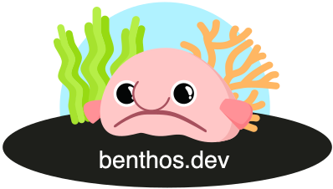
Data engineering at scale: Real-world case studies with Benthos
Mihai Todor
Jan 19th, 2024

Slide 2
About me
Principal Software Engineer, currently freelancing
16+ years of experience in industry and academia
Backend microservices and infrastructure / scalability / public cloud SaaS
Golang, Python, C++
Open Source contributor
https://www.linkedin.com/in/mtodor
https://github.com/mihaitodor

Slide 3
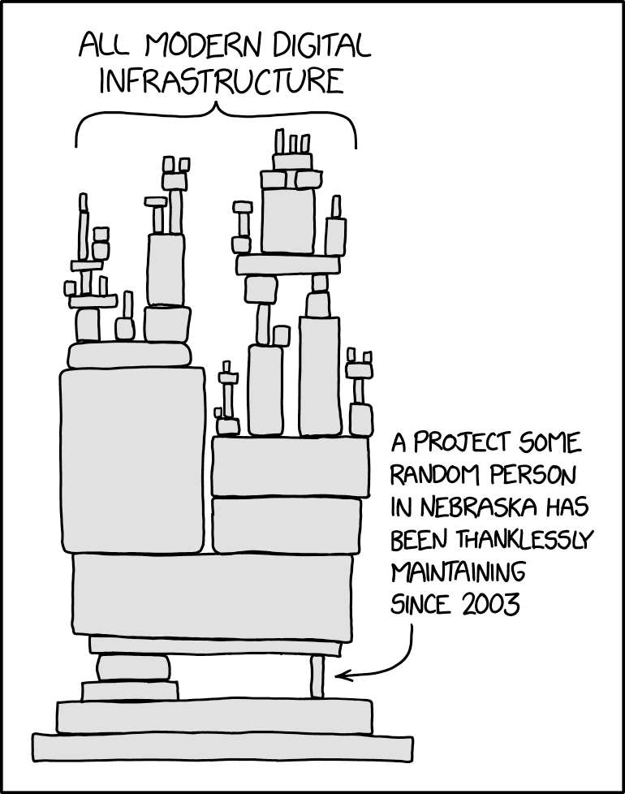
What do SaaS platforms look like behind the scenes?
Source: https://xkcd.com/2347

Slide 4
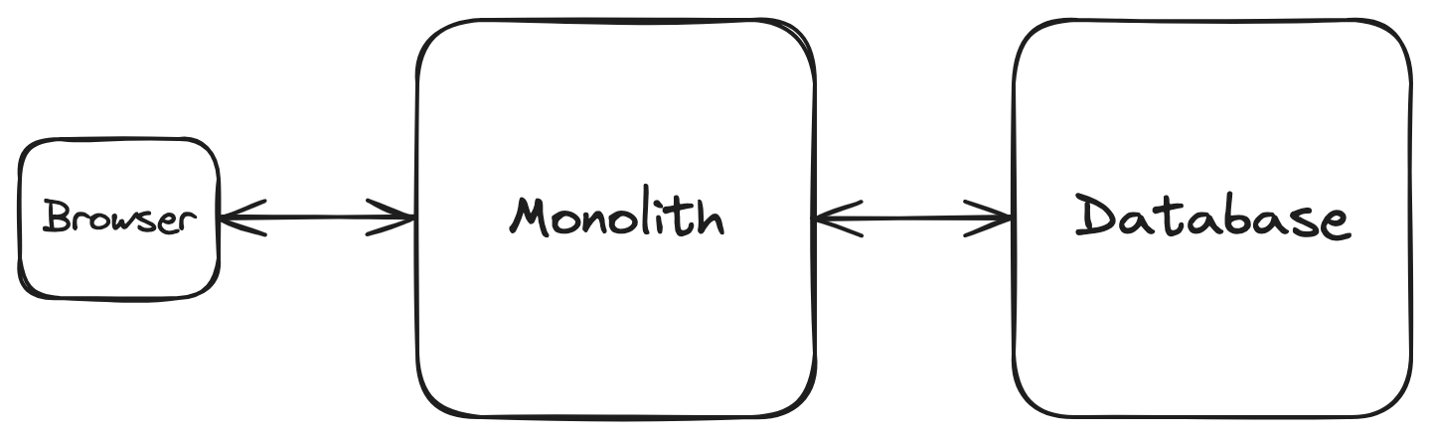
Let’s build a LinkedIn clone

Slide 5
Divide the LinkedIn clone monolith into microservices
Product feature services
Timeline
Users
Interactions
Messaging
Payments
Ads
…
Auxiliary services
Schedulers and orchestrators
Databases
Storage
Analytics
Audit log
APIs
…

Slide 6
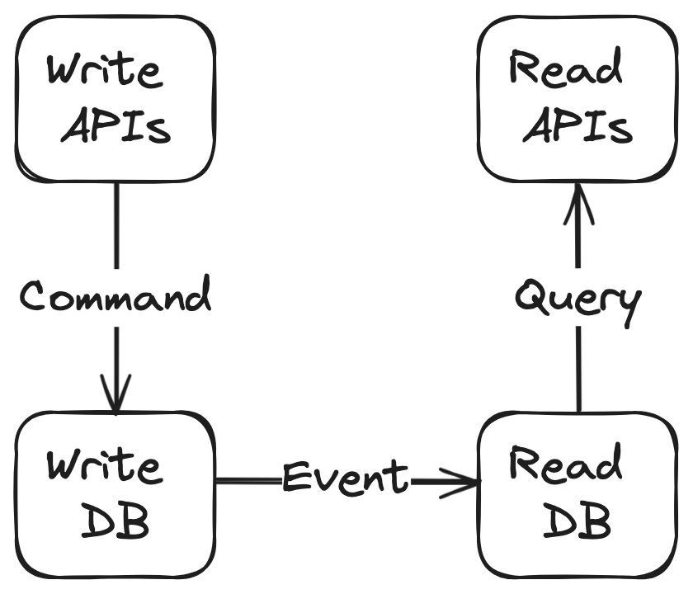
CQRS - Command query responsibility segregation
Details: https://docs.aws.amazon.com/prescriptive-guidance/latest/modernization-data-persistence/cqrs-pattern.html

Slide 7
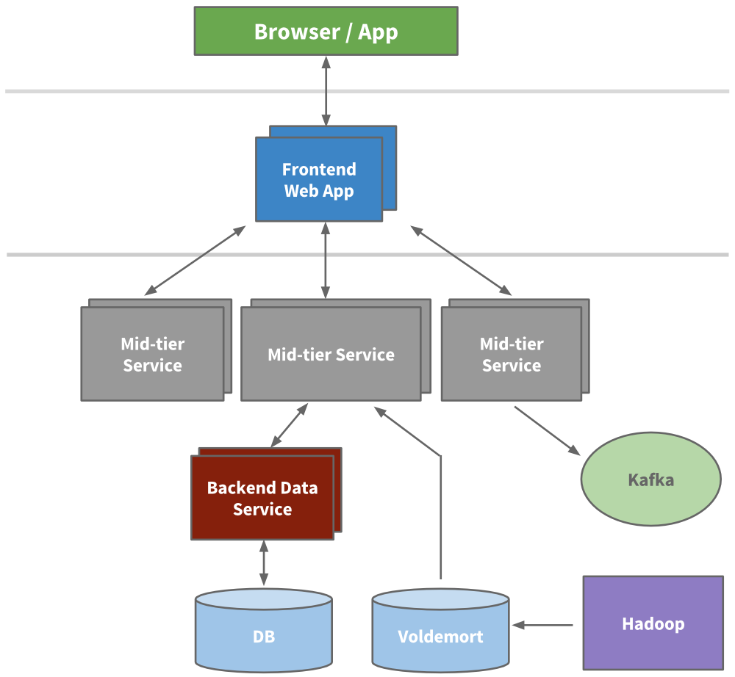
LinkedIn’s high level system architecture (2015)
Source: https://engineering.linkedin.com/architecture/brief-history-scaling-linkedin

Slide 8
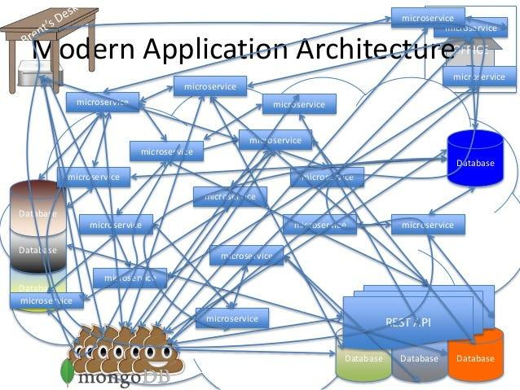
LinkedIn clone microservice architecture
Source: https://www.slideshare.net/danveloper/microservices-the-right-way

Slide 9
What else?
Code repositories
CI/CD (Continuous integration and continuous delivery/deployment)
Monitoring and alerting
Container image registry
CDNs (content delivery network)
VPCs & Firewalls
…

Slide 10
Users JSON REST API service for our LinkedIn clone
Use favourite programming language
Import HTTP libraries
Import the JSON libraries
Import the database client libraries
Write a bunch of glue code
Build a Docker image
Run it as a Docker container in Kubernetes

Slide 11
What’s missing?
Resource limits (memory, CPU, disk and network on individual nodes aren’t infinite)
Metrics
Logging
Retries
Rate limiting and throttling
Batching
Caching
Scaling (high availability, fault tolerance, etc)
Security
Extensibility and maintainability

Slide 12
Twelve-factor apps: https://12factor.net
Codebase
Dependencies
Config
Backing services
Build, release, run
Processes
Port binding
Concurrency
Disposability
Dev/prod parity
Logs
Admin processes

Slide 13

What is Benthos? https://www.benthos.dev
Hint: It has nothing to do with deep sea fish, except for the logo

Slide 14

Disclaimers
Thoughts expressed here are my own
Benthos is owned and maintained by Ash: https://twitter.com/Jeffail
Ash designed and built Benthos from scratch
I am a contributor to the project

Slide 15
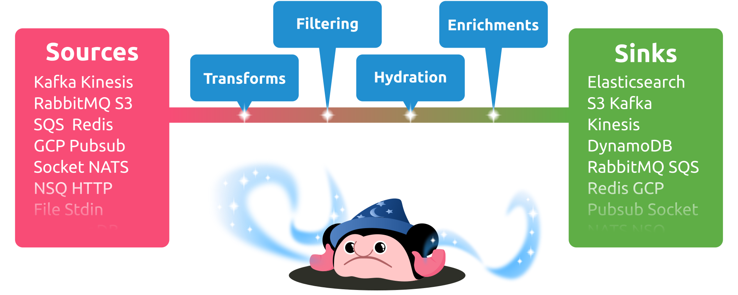
What is Benthos for?
“Fancy stream processing made operationally mundane” - Ash Jeffs

Slide 16

Boringly easy to use
# Install
curl -Lsf https://sh.benthos.dev | bash
# Make a config
benthos create stdin/mapping/stdout > ./config.yaml
# Run
benthos -c ./config.yaml

Slide 17

Features
Declarative YAML-based configuration
Single message transforms
Stateless
At least once delivery
Metrics and logging
Custom Plugins
Written in Go

Slide 18

Bloblang
root.new_doc = match this.doc {
this.type == "article" => this.article
this.type == "comment" => this.comment
_ => this
}
Custom DSL for arbitrary data transforms
{
"doc": {
"type": "article",
"article": {
"id": "foo",
"content": "qux"
}
}
}
{
"new_doc": {
"id": "foo",
"content": "qux"
}
}

Slide 19


Deployment models
Standalone CLI app
Serverless
Kubernetes

Slide 20
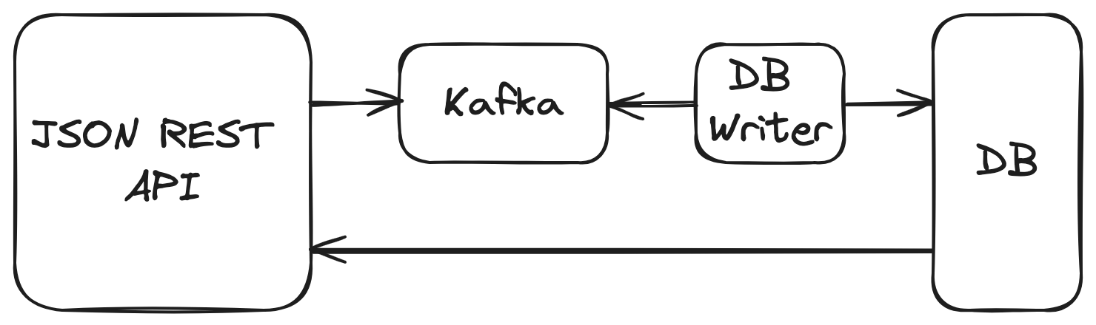
Case study: JSON REST API

Slide 21

Importing Benthos as a library
package main
import (
"context"
"github.com/benthosdev/benthos/v4/public/service"
// Import minimal Benthos components
_ "github.com/benthosdev/benthos/v4/public/components/io"
_ "github.com/benthosdev/benthos/v4/public/components/pure"
)
func main() {
service.RunCLI(context.Background())
}
Source: https://github.com/benthosdev/benthos-plugin-example

Slide 22
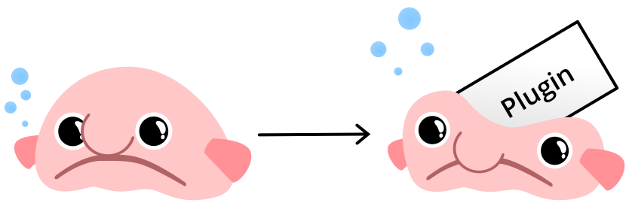
Writing a custom Benthos plugin
type processor struct{}
func (r *processor) Process(ctx context.Context, m *service.Message) (service.MessageBatch, error) {
println("foobar")
return nil, nil
}
func (r *processor) Close(ctx context.Context) error { return nil }
func init() {
_ = service.RegisterProcessor("foobar",
service.NewConfigSpec(),
func(conf *service.ParsedConfig, mgr *service.Resources) (service.Processor, error) {
return &processor{}, nil
},
)
}
// > ./benthos create -s stdin/foobar/stdout > config.yaml
// > ./benthos -c config.yaml

Slide 23


Future enhancements and goodies
More adapters
Custom plugins
Benthos Studio

Slide 24
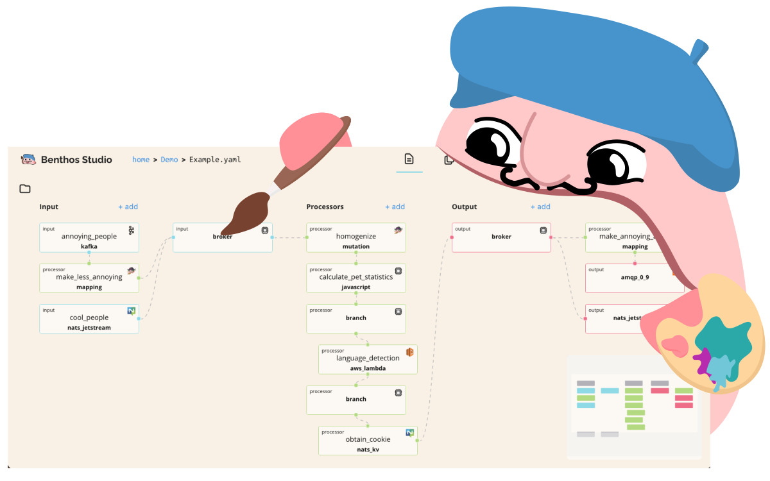
Benthos Studio

Slide 25
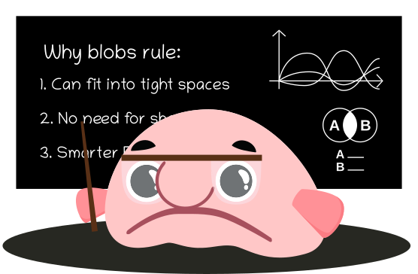
Why Open Source?
Built on the shoulders of giants
Community-driven features, enhancements and bug fixes
High quality standards enforced uniformly
Open issue tracker and permanent change history
Avoids vendor-driven lock-in

Slide 26

Open Source Needs You!

Slide 27



Community https://www.benthos.dev/community
https://discord.gg/6VaWjzP
https://invite.slack.golangbridge.org
#benthos channel

Slide 28

Thank you!
Happy to answer your questions!

